Slide 1
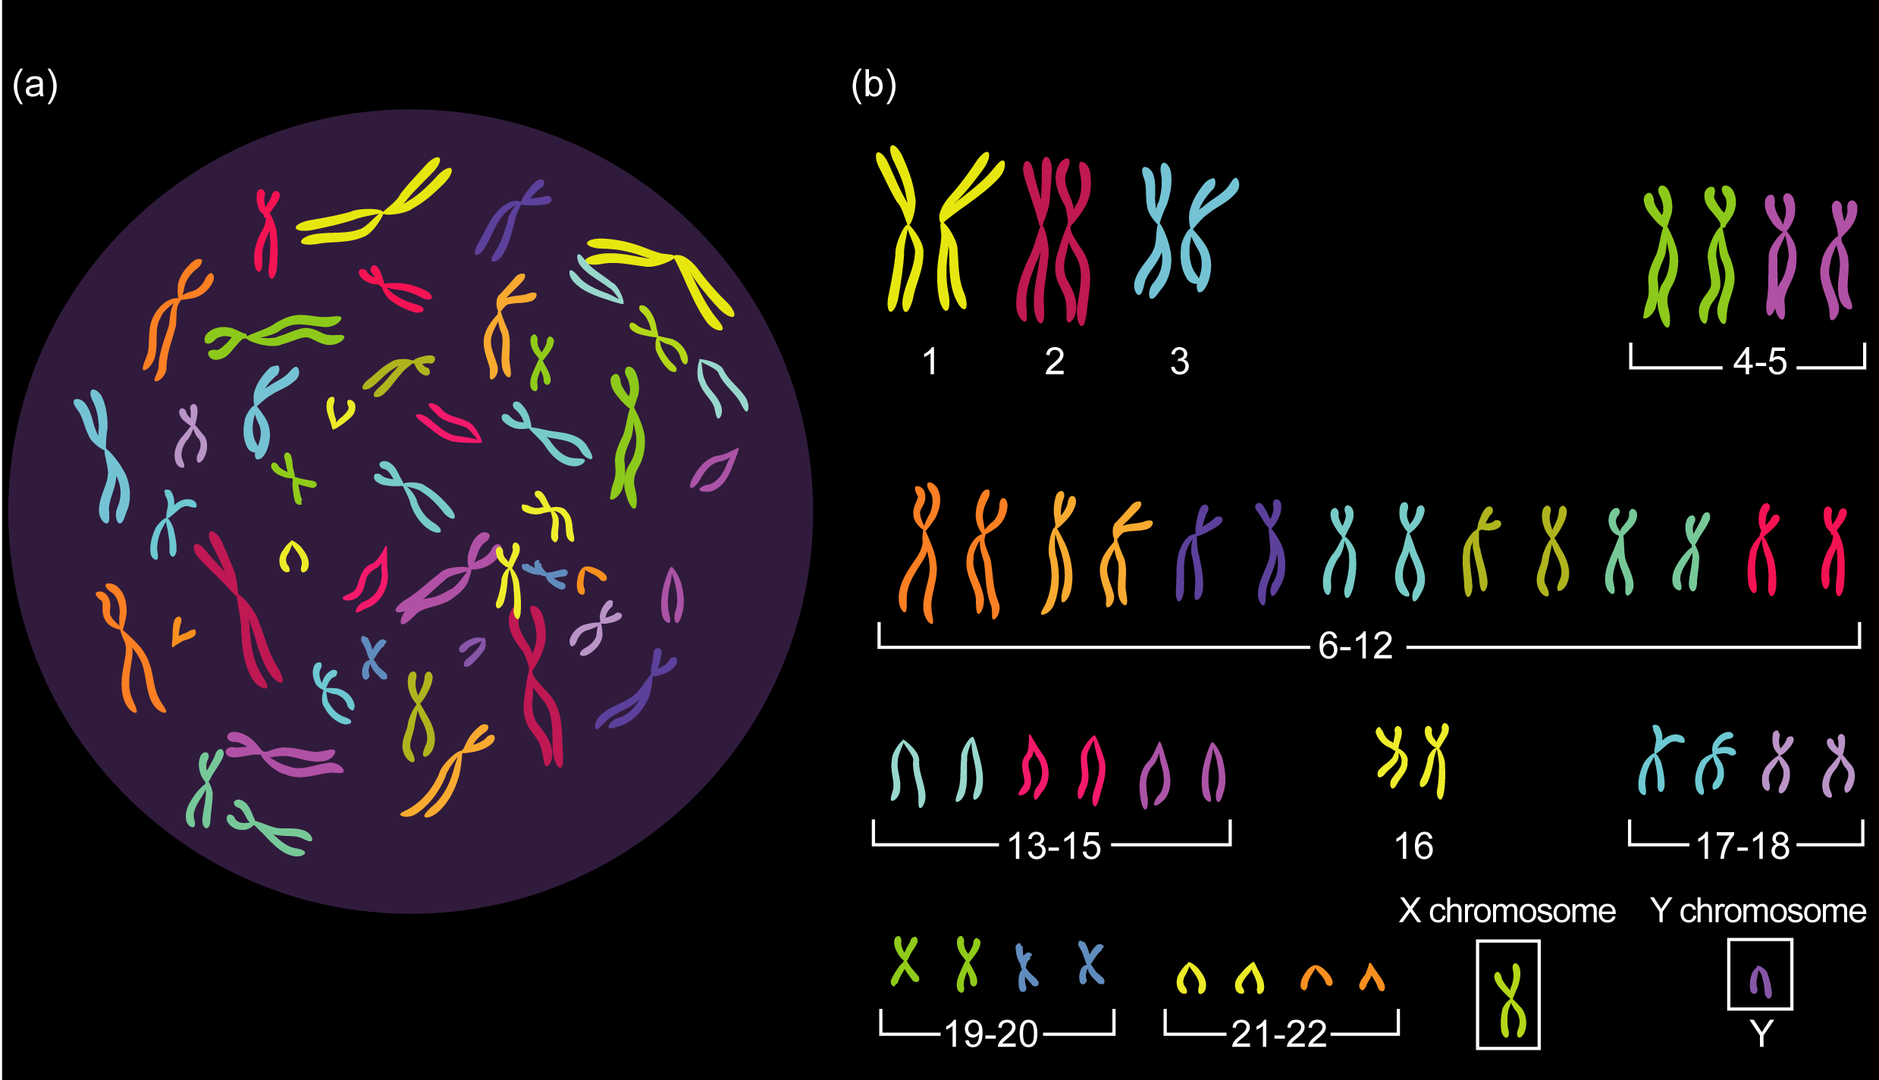
Inheritance
Inheritance is the transmission of genetic information from generation to generation.
Genetics is the branch of biology that studies heredity and variation in organisms.

Slide 2
Terminology part 1
Inheritance
Chromosomes
Sister chromatids
Centromere
Gene
Haploid nucleus/ cell
Diploid nucleus/ cell

Slide 3
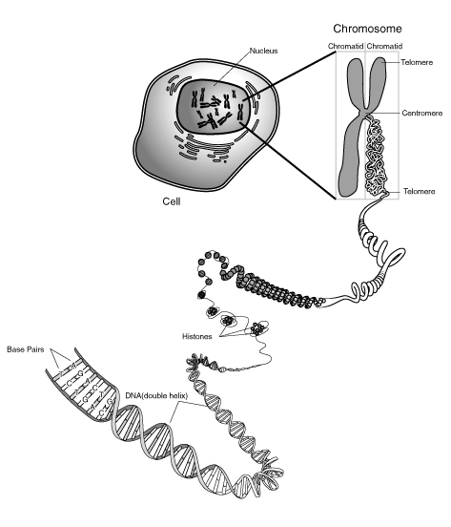
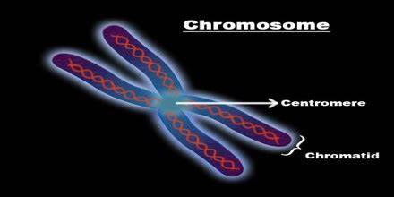
Chromosomes
Define gene.
Notes:
Genes are segments of DNA found on chromosomes that carry information for protein production and that are responsible for the inheritance of specific traits.

Slide 4
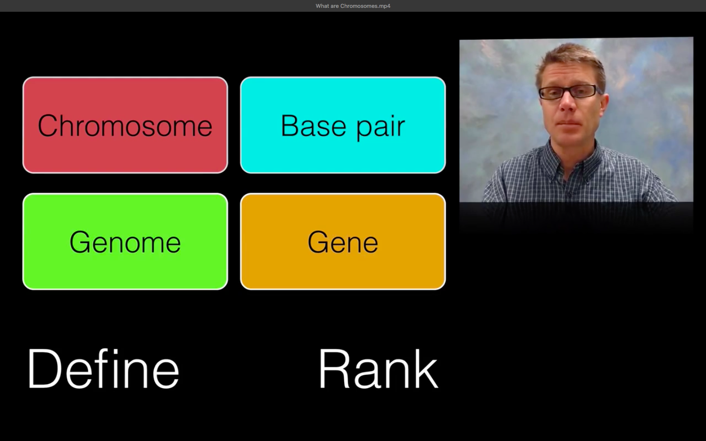
Activity 1
Define gene.
Define genome.
Rank the 4 terms from biggest to smallest scale.

Slide 5
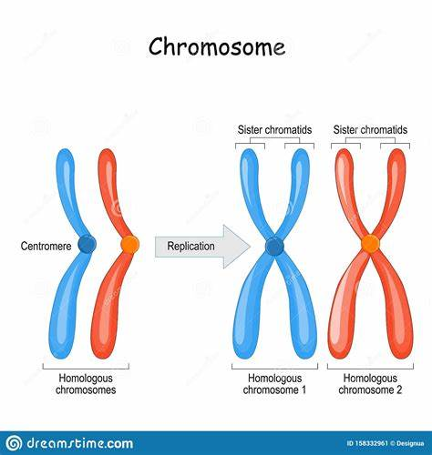
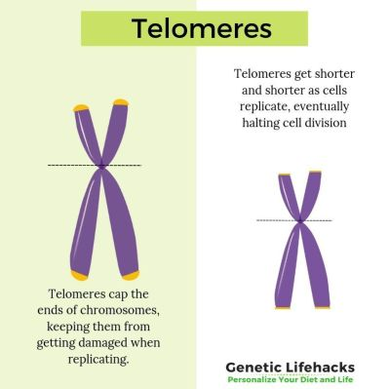
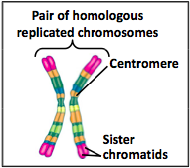
chromosomes

Slide 6
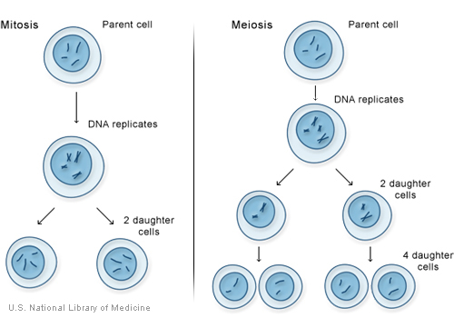
There is a cell with 2 homologous pair of chromosomes. A diagram is drawn to show the processes of mitosis and meiosis.
Activity 2. Can you compare the similarities and differences between mitosis and meiosis?
Homologous chromosomes pair up and cross over (exchange of sequences)
Homologous chromosomes separate
Sister chromatids separate
Sister chromatids separate

Slide 7
Activity 2 Comparing mitosis and meiosis
 | Mitosis | Meiosis
similarities
differences

Slide 8
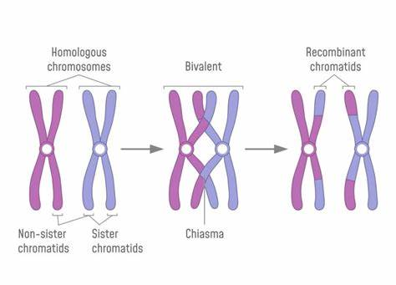

Crossing-over

Slide 9
Mitosis
There are two types of cell division: mitosis and meiosis.
Mitosis is involved in:
growth
repair of damaged tissues, replacement of worn-out cells
asexual reproduction.

Slide 10
Activity 2
Simulate a cell possessing 3 pairs of homologous chromosomes experiencing mitosis & meiosis using a stack of cards.

Slide 11
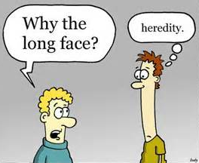
Inheritance

Slide 12
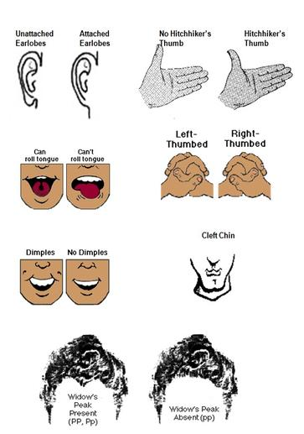
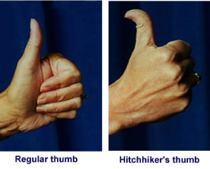
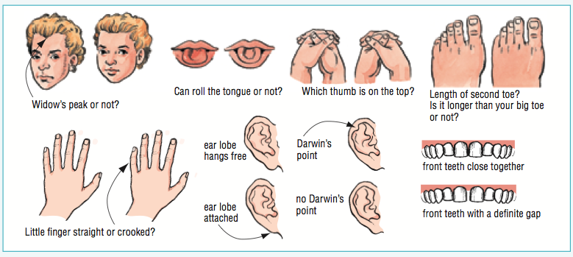
Inheritance
…

Slide 13
Alleles
An allele is:
Any of two (or more) alternative forms of a gene.
Two forms of a gene, called alleles, code for a particular characteristic.
The alleles can be the same or they can be different.
Some alleles are dominant, while others are recessive.
Notes:
Many genes, however, are represented by multiple allelic forms within a population. (One individual, of course, can possess only two of these multiple alleles.) Human blood groups—in this case, the well-known ABO system—again provide an example. The gene that governs ABO blood types has three alleles: IA, IB, and IO. IA and IB are codominant, but IO is recessive.

Slide 14
Terminology part 2
Aa
Dominant allele
Recessive allele
Allele
Homozygous VS Heterozygous
Genotype VS Phenotype
Dominant VS Recessive
Test cross
Pure breeding
F1 generation (the first filial generation)
F2 generation (Second filial generation)
A specific variation of a gene.
A cross is done between an organism exhibiting the dominant trait (dominant phenotype) and another organism displaying the recessive trait (recessive homozygote) in order to determine the the dominant genotype.
Refers to producing offspring that would carry the same phenotype as the parents. Thus, a purebred would result when the parents are homozygous for certain traits.
comprised of offspring resulting from a cross between two individuals from parental generation (P generation)
Q: What does the chinchilla breeding story (P230) tell us? Which allele is dominant?
The filial generation comprised of offspring(s) resulting from a cross between two individuals from the first filial generation
Notes:
Different alleles produce slightly different proteins, which function in different ways.
In dominant/recessive relationships, the recessive allele produces a non-functional protein. The dominant allele produces a functioning protein. A heterozygous individual will appear the same as a homozygous dominant individual. This means that an organisms with two dominant alleles appear the same as an organism with only one functioning allele. Many enzymes are able to process their substrates so fast that one functional allele can produce enough enzyme to service the needs of the organism.
The accuracy the test cross results will therefore depend on the availability of a large statistical sample.

Slide 15
Pure breeding
A purebred of domesticated animal or a pet animal can be achieved through the process of selective breeding.
For example, two dogs of the same breed would have an offspring with rather predictable traits.
Nevertheless, selective breeding between same breed would be disadvantageous in terms of gene pool. It tends to limit the gene pool.
A large gene pool means greater genetic diversity. And higher genetic diversity could mean increased chances of biological fitness, and therefore of survival.
In contrast, a gene pool that is restricted could lead to low genetic diversity. This reduces the chances of inheriting favourable traits that increase biological fitness.
Purebreds are susceptible to acquiring genetic diseases or congenital health problems because of limited gene pool. (inbreeding depression)
A purebred dog refers to modern breeds of dog, which are documented so as to be known to be descended from specific ancestors, that closely resemble others of their breed in appearance, movement, way of working and other characters; and that reproduce with offspring closely resembling each other and their parents.
Notes:
Inbreeding depression is the reduced biological fitness in a given population as a result of inbreeding, or breeding of related individuals.

Slide 16
Genetic diagram
Parents’ phenotype | Tall | Dwarf
Parents’ genotype | Tt | tt
Alleles in gametes | T t | t t
The cross/ the Punnett Square | eggs sperms
offspring phenotype ratios | Tall: Dwarf = 1:1
offspring genotype ratios | Tt : tt = 1:1
 | T | t
t | Tt | tt
t | Tt | tt

Slide 17
Punnett square
A Punnett square is a graphical representation of the possible genotypes of an offspring arising from a particular cross or breeding event.
Creating a Punnett square requires knowledge of the genetic composition of the parents.
The various possible combinations of their gametes are encapsulated in a tabular format. Therefore, each box in the table represents one fertilization event.

Slide 18
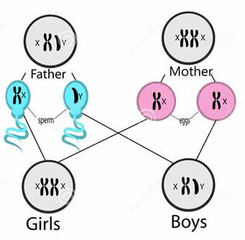
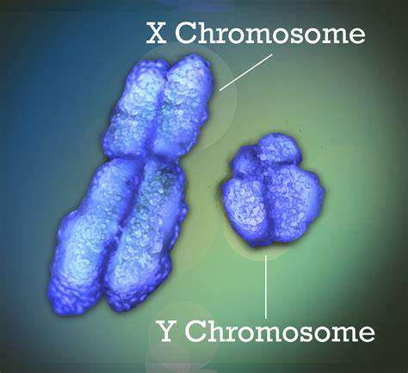
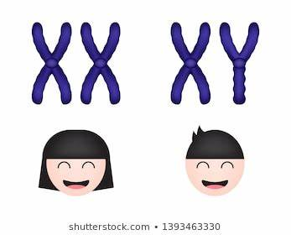
Sex inheritance
Q: Can you draw a genetic diagram to explain the possibility of sexes of children from a couple?
Notes:
In humans and other mammals, biological sex is determined by a pair of sex chromosomes: XY in males and XX in females.

Slide 19
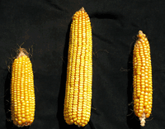
Introduction
In maize, plants with the genotype Tt are tall, while those with the genotype tt are short.
What is the phenotype of a plant with the genotype TT?
Which is the recessive allele?

Slide 20
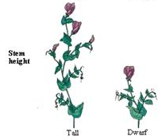
Question 1
In peas, there is a gene for controlling plant height. T is the dominant allele for tall plants and t is the recessive allele for dwarf (short) plants.
a) What will be the phenotype of a plant with the genotype Tt?
Tall.
b) If two plants with the Tt genotype are crossed, what proportion of the offspring will be tall?

Slide 21
Question 1
Parents’ phenotype | Tall |  |  | Tall
Parents’ genotype | Tt |  |  | Tt
Alleles / Gametes | T t |  |  | T t
[The cross] |  | T | t
 | T | TT | Tt
 | t | Tt | tt
 |  |  |  | Ratios
offspring phenotype | Tall: Dwarf |  |  | 3:1
offspring genotype | TT: Tt: tt |  |  | 1: 2: 1

Slide 22
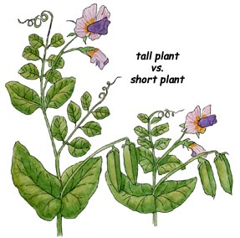
Question 1
c) If a plant with the Tt genotype is crossed with a homozygous recessive plant, what proportion of the offspring would be dwarf?
d) Two pea plants were crossed. Half the offspring were tall, the other half were dwarf.
Explain, with a genetic diagram, how this is possible.

Slide 23
Question 1
Parents’ phenotype | Tall |  |  | Dwarf
Parents’ genotype | Tt |  |  | tt
Alleles | T t |  |  | t t
[The cross] |  | T | t
 | t | Tt | tt
 | t | Tt | tt
 |  |  |  | Ratios
offspring phenotype | Tall: Dwarf |  |  | 1:1
offspring genotype | Tt : tt |  |  | 1:1

Slide 24
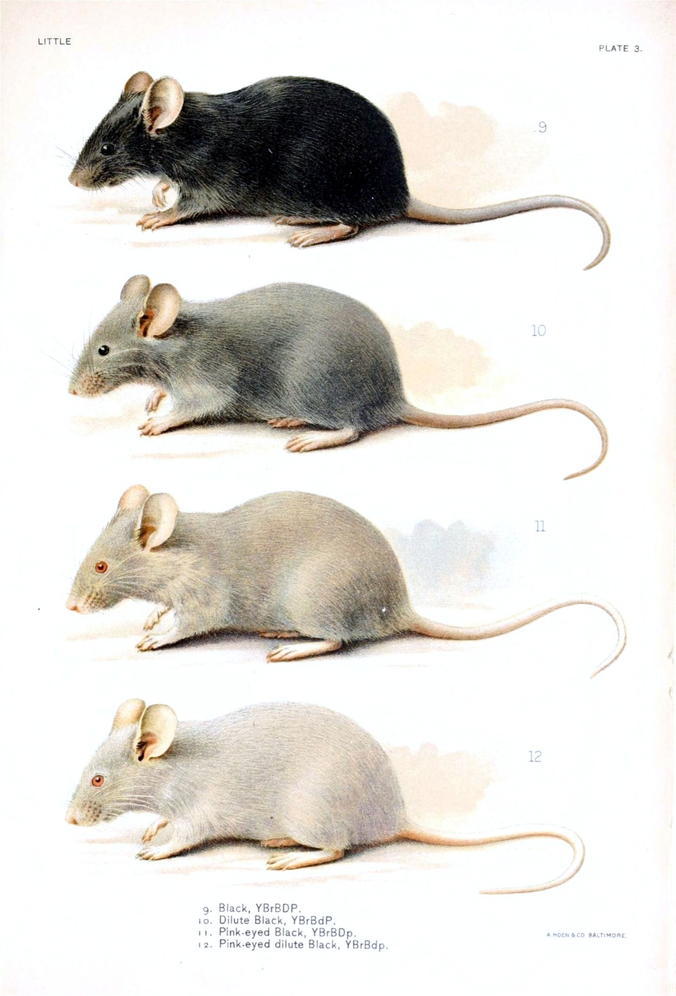
Question 2
In mice, the allele for black coats is dominant to that for white coats.
(a) What would be the genotypes and phenotypes of the offspring of a cross between a pure bred (= homozygous) black coat female and a pure bred white coat male?
(b) If two of the F1 generation were crossed, show the phenotypes and genotypes of the F2 generation.

Slide 25
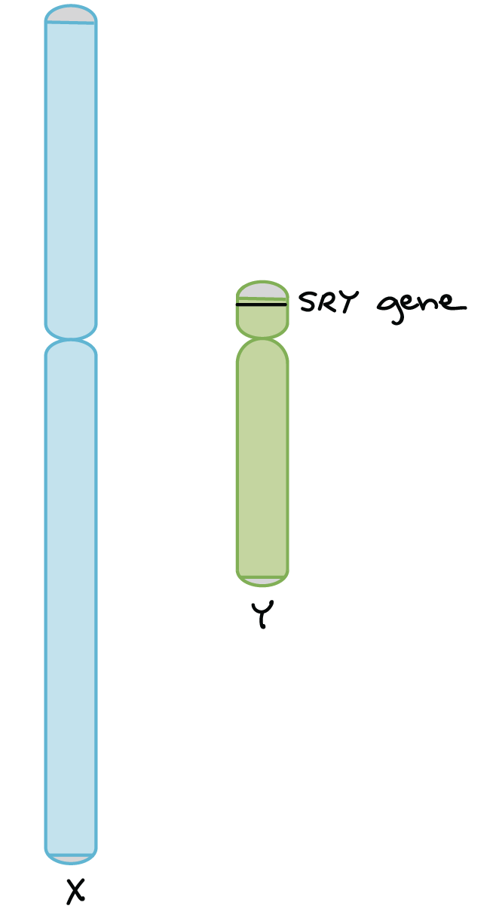
Sex determination in human
The X chromosome has about 800- 900 protein-coding genes with a wide variety of functions, while the Y chromosome has just 60−70 protein-coding genes, about half of which are active only in the testes (sperm-producing organs).
The human Y chromosome plays a key role in determining the sex of a developing embryo. This is mostly due to a gene called SRY (“sex-determining region of Y”). SRY is found on the Y chromosome and encodes a protein that turns on other genes required for male development.
XX embryos don't have SRY, so they develop as female.
XY embryos do have SRY, so they develop as male.

Slide 26
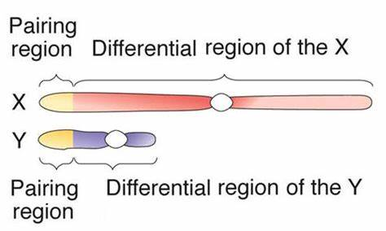
Sex linkage
https://www.thoughtco.com/sex-linked-traits-373451
Q: In fact, around 1 in 20 men is colorblind and only 1 in 400 women is. What does this tell you? Where is the disease-causing allele (on which chromosome)?
Sex-linked traits are genetic characteristics determined by genes located on sex chromosomes.
Sex linked genes are genes that are on the non-homologous part of sex chromosomes (X or Y) and that are therefore inherited differently between males and females.
E.g. X-linked recessive traits red-green color blindness & hemophilia (a blood disorder in which certain blood clotting factors are not produced).
Q: What about the inheritance of genes on the homologous part of X and Y chromosomes?
Q: If an X-linked recessive allele causes a disease, will it influence men or women more in the population? What about X-linked dominant traits?
Since males only have one X chromosome (XY), in X-linked recessive traits, the phenotype is fully expressed.
A hereditary carrier (or just carrier), is a person or other organism that has inherited a recessive allele for a genetic trait or mutation but usually does not display that trait or show symptoms of the disease.
Notes:
A person with color blindness has difficulty seeing color differences. Red-green color blindness is the most common form and is characterized by the inability to distinguish shades of red and green.

Slide 27
Question – color blindness
1. When a normal vision woman is married to a colour blind man (P generation), their children (daughters and sons) have normal colour vision.
But when their daughters (F1 generation) were married to normal man, 50% of their sons (F2 generation) are colour blind and the remaining 50% are normal.
What will the phenotypes of daughters in F2 generation be?
Can you work out the genotypes of P generation?
2. If a colour blind woman marries a normal man, what are the phenotypes of their children?
3. If a normal vision carrier woman marries a color blind man, what are the phenotypes of their children?

Slide 28
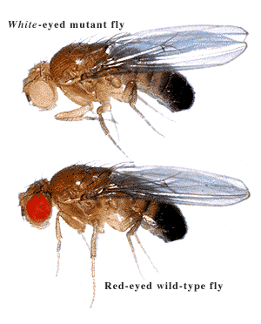
Question
Eye color in fruit fly Drosophila (which, like humans, has XX females and XY males) is an X-linked trait. Red eye allele X^{W} is dominant to white eye allele X^{w}.
When a red-eyed male fruit fly is crossed with a white-eyed female fruit fly.
(a) What are the parental genotypes?
(b) What are the possible genotype of the F1 generation? Draw a genetic diagram to illustrate your results.
(c) Show the results of a cross between an F1 female with a white-eyed male.

Slide 29
Monohybrid & dihybrid
A monohybrid cross is a breeding experiment between P generation (parental generation) organisms that differ in a single given trait. The P generation organisms are homozygous for the given trait.
A dihybrid cross is a breeding experiment between P generation (parental generation) organisms that differ in two traits. The individuals in this type of cross are homozygous for a specific trait. The inheritance of two traits are independent.
https://www.thoughtco.com/dihybrid-cross-a-genetics-definition-373463
https://www.thoughtco.com/monohybrid-cross-a-genetics-definition-373473

Slide 30
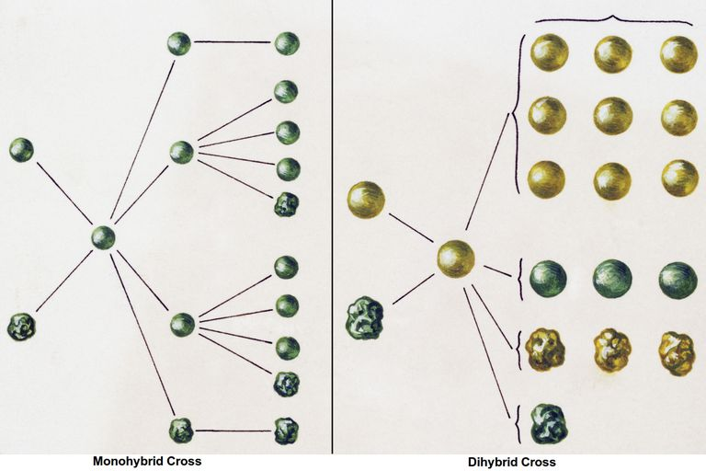
Seed shape is studied.
seed color and seed shape are studied.

